Slide 1

ENSE 271 Activity #2 Coruscantiens
Feras Daghmoush (3rd year SSE)
Ria chevli (3rd year SSE)
Zhuo Chen (4th year SSE)
Jacob Chapman (4th year SSE)

Slide 2
Events page
Careers page
Home page
About us page
My account page

Slide 3


Our design has :
Desktop version has new features
Navigation bar is now on the left side of the screen
Smooth content running from left to right.
Mobile home page enhanced functionality makes one hand navigation fun.
Developed to satisfy the user Z scanning (corner to corner)

Slide 4
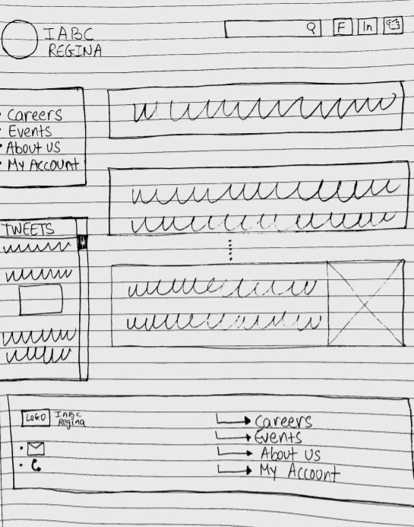
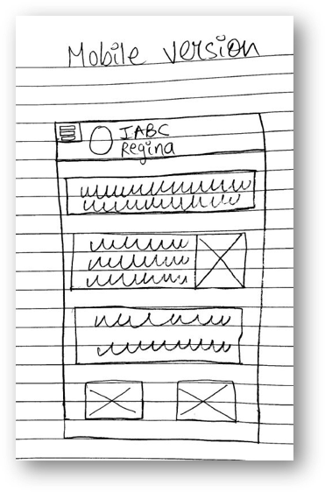
Home Page Design
Desktop Version
Phone version

Slide 5

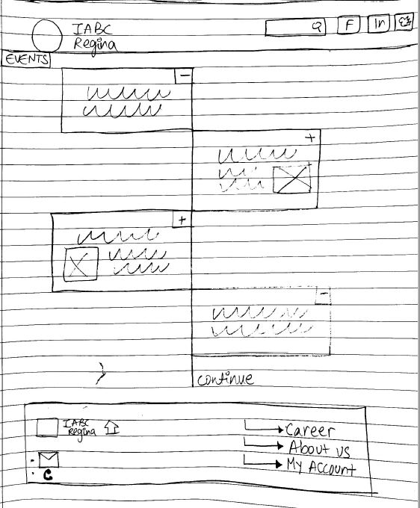
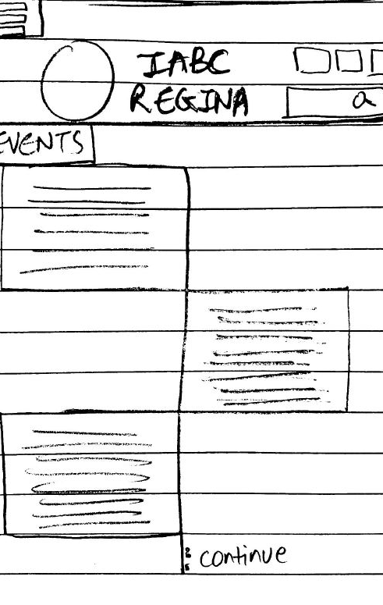
Events Page Design
Desktop Version
Phone version
Functional posting section to share and reduce cluttering

Slide 6

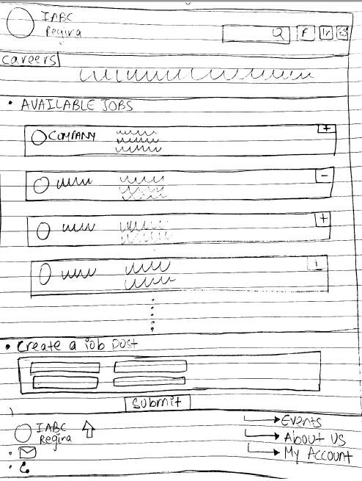
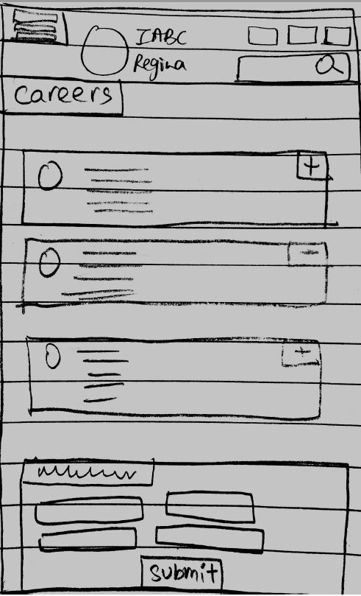
Careers Page Design
Desktop Version
Phone version
Job posting section to reduce cluttering

Slide 7

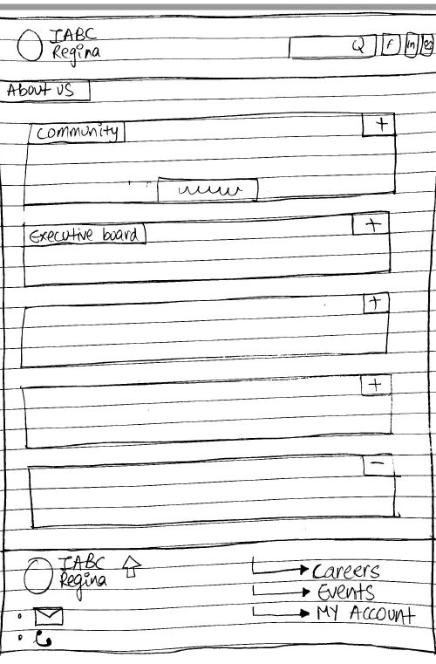
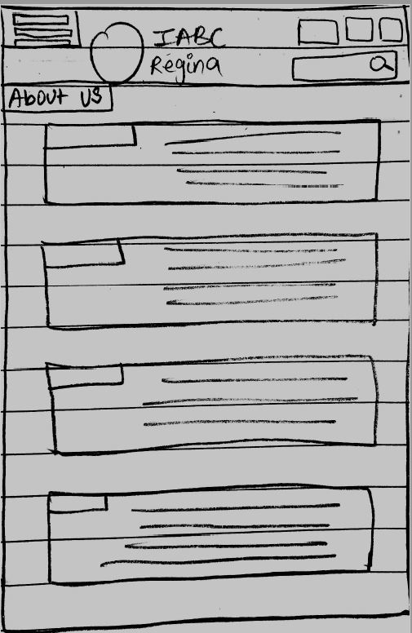

About IABC
Desktop Version
Phone version
Merging contact us & About us to avoid reptation
Chat box needed ?

Slide 8

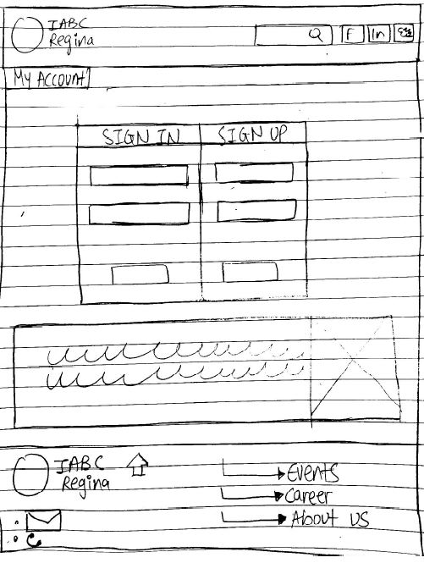
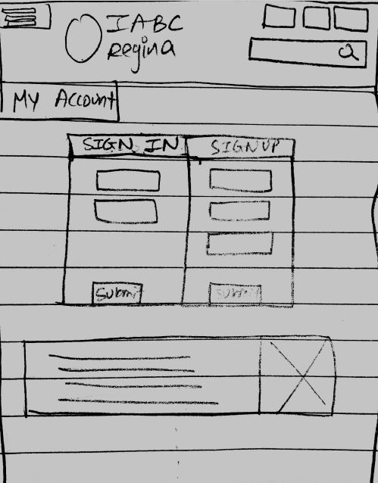
My Account Page Design
Desktop Version
Phone version

Slide 9
Thank you
Feedback & comments

